Slide 1
Medication Administration for Unlicensed Personnel

Slide 2
UCPS Board of Education Medication Policy
UCPS discourages giving medication at school unless necessary. Parents should try to schedule medication with their physician outside of school hours.

Slide 3
UCPS discourages giving medication at school unless necessary.
True
False

Slide 4
Correct !
Continue onto the next slide

Slide 5
That’s not Correct
Please go back and try again

Slide 6
UCPS Board of Education Medication Policy
c. Pursuant to N. C. Gen. Stat 115C-375 . 1 the Board of Education authorizes teachers, substitute teachers, student teachers, instructional assistants, school secretaries and office personnel, guidance counselors, assistant principals, and principals to administer medications prescribed by a health care provider upon written request of a parent of guardian or to administer non-prescription medications upon the request of a parent or guardian as provided in this policy. Each principal will designate the person(s) responsible for giving medication at his/her school. The person(s) will receive annual training in safe, accurate medication administration procedures with the school nurse.
An Individual Health Plan will be on file for those students in danger of
a medical emergency

Slide 7
North Carolina Law allows for unlicensed personnel to give medication in school without training from a school nurse.
True
False

Slide 8
Correct !
Continue to the next slide

Slide 9
That’s not Correct
Please go back and try again

Slide 10
UCPS Board of Education Medication Policy
D. When medication is requested to be administered in school, school personnel should review the UCPS School Board policy with parent or guardian.

Slide 11
UCPS Board of Education Medication Policy
Parent Responsibilities
Obtain and return to school a medication consent form, signed by the
doctor and the parent for
prescription and over the counter meds.
The parent/guardian must hand deliver the medication to the nurse or office staff at school in the original container.

Slide 12
When medication is brought into school.
A. Its ok to accept the medication and have the nurse get the paperwork later.
B. The student can bring the medication on the bus as long as the parent says its ok
C . No medication can be accepted at school unless it is in the proper labeled container and has a medication consent signed by the doctor and parent.
D. If the prescription is on the medication, no other paperwork is needed.

Slide 13
That’s Correct !
Please continue to the next slide

Slide 14
That’s not correct
Please go back and try again

Slide 15
UCPS Board of Education Medication Policy
G. A locked storage area must be provided for medications except for medication that must be kept in the refrigerator. Emergency medication must be kept in a easily accessible location.

Slide 16
Medication must be kept in
A. An easily accessible but locked location.
B. An unlocked location easily accessible.
C. An easily accessible but locked location, except for medication that must be refrigerated
D. On the desk or counter in the office or health room.

Slide 17
That’s Correct !
Please continue to the next slide

Slide 18
That’s not correct
Please go back and try again

Slide 19
UCPS Board of Education Medication Policy
H-K
A daily log will be set up and reviewed by the school nurse for the unlicensed personnel to record the medication.
Logs will be sent on field trips if needed.
All medication logs will be kept in the Individual Student Health Record.
Changes in dosage may be accepted via fax from a doctor’s office and a new log created by the school nurse.

Slide 20
Medication logs are legal documentation. You need to write all medication given on the log and give to the nurse.
True
False

Slide 21
That’s Correct !
Please continue to the next slide

Slide 22
That’s not correct
Please go back and try again

Slide 23
Changes in doses of medication must be confirmed by a licensed health care provider and can be faxed to the school nurse who will change the medication log.
True
False

Slide 24
That’s Correct !
Please continue to the next slide

Slide 25
That’s not correct
Please go back and try again

Slide 26
UCPS Board of Education Medication Policy
K-M Self Possession and Administration
Students are not allowed nor is UCPS personnel responsible for medication taken by students that does not have permission from a physician and parent.
Students are not allowed to carry medications home, unless they are emergency medications like an epi pen, or inhaler.
Check with the School Nurse for students eligible to self carry.

Slide 27
UCPS is not liable for any student that takes medication without the knowledge of the school nurse or medication administrator and the proper paper work completed.
True
False

Slide 28
That’s Correct !
Please continue to the next slide

Slide 29
That’s not correct
Please go back and try again

Slide 30
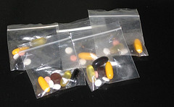
Pointers for Safe Medication Administration
Parents provide:
Medication Consent signed by parent and MD (faxes are acceptable)
Medication must be in the original prescription bottle or for over the counter meds, the original box/ container.
Never give unidentified pills from a baggie, napkin, envelope or travel pill carrier!

Slide 31
IMPORTANT!
If medication is brought to school without a properly completed medication consent form, the medication CANNOT be given.
Return the medication to parents until they can bring in the medication with the completed medication consent form.
If a parent insists their child needs the medication that day then they need to come and administer it themselves.

Slide 32
Medication can only be given with a medication consent signed by a health care provider and it must be in the original container. No baggies or loose pills.
True
False

Slide 33
That’s Correct !
Please continue to the next slide

Slide 34
That’s not correct
Please go back and try again

Slide 35
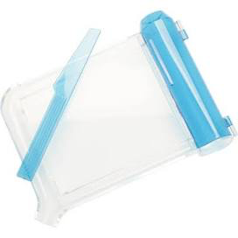
Recording Controlled Substances
When “controlled substance” medications are brought in for students they must be counted and recorded on the medication log (in spaces at the bottom of the log).
Most ADHD medication is a controlled substance. Count and record on log if you aren’t sure.
Parents must bring in their children’s medication.
o
o

Slide 36
When Medications Run Low
Send a reminder to parents when there is a 5 day supply remaining or Alert Nurse
On the bottom of the medication log there are spaces to record information such as:
“Meds Needed” reminder home
“Empty Bottle” home
Pill count for controlled substance
Any phone/note communication with parent
Communications with a school nurse/doctor

Slide 37
Count and record controlled substances on Medication log. Inform parent or nurse if student has less than 5 day supply
True
False

Slide 38
That’s Correct !
Please continue to the next slide

Slide 39
That’s not correct
Please go back and try again

Slide 40
HELP!!!!
If you have ANY questions or doubts about a medication:
Should I give this?
Is this right?
Is this controlled substance?
Something does not seem right?
Parent is mad, asking me to do something I should not do
Call your Nurse or Supervisor

Slide 41
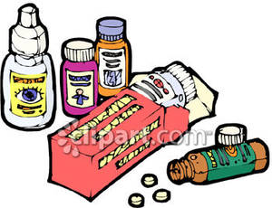
Medication Administration
Five Rights of Giving Medication
Right Patient
Right Medication
Right Dose
Right Time
Right Route
Documentation

Slide 42
Medication Administration
The Right Patient
Of course you will give it to the right student! Be careful, it is easy to get confused when you are busy and may mistake them for someone else.
Always confirm the students name.

Slide 43
Medication Administration
Right Medication
Check the bottle or inhaler against the medication consent form. Make sure you are giving the right medication. The medication should be in an original bottle and labeled with the student name, medication, and dose. And not expired
No Baggies with pills

Slide 44
Medication Administration
Right Dose
Check the medication consent form. Make sure you are calculating correctly
150 mg = 2 75 mg tablets
5mg per ml. 15 mg = 3 ml
If you are unsure, check with a school nurse

Slide 45
Medication Administration
Right Time
Give medication as close to the time ordered as possible. You can give 30 minutes either way and still be on time.
More than 30 minutes, call parent and inform especially for ADHD medication.

Slide 46
Medication Administration
Right Route
Make sure they are taking the medication the right way.
Oral, injectable, topical, rectal, inhaled
Watch that medication is actually swallowed.

Slide 47
Every Time I give medication I need to make sure I have the right student, the right patient, the right dose, the right time, the right route.
A. True
B. False

Slide 48
That’s Correct !
Please continue to the next slide

Slide 49
That’s not correct
Please go back and try again

Slide 50
Giving oral medication
Wash your hands before you give medication.
Pour the medication in the cap of the bottle.
Put the medication in the hand of the student
Watch to make sure student swallows medication in front of you.

Slide 51
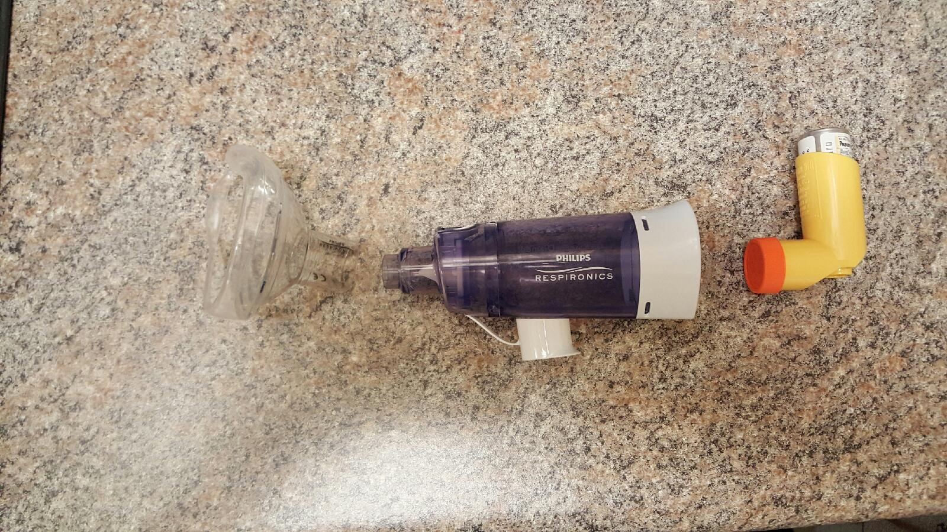
Medication by Inhaler ( spacer)
Inhalers
Without spacer
Have student take cap off inhaler
and breathe out. Take a deep breath
In while squeezing medication.
Repeat after 1 minute
With spacer
Connect mask if available and inhaler to spacer tube place mask on face or end of tube in mount. Squeeze inhaler and breath normally 4-5 times. Repeat after 1 minute.

Slide 52
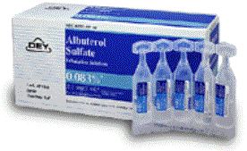
Nebulizer Treatments
Unscrew top of
medication chamber.
Twist of top of plastic vial
Squirt liquid into chamber
Place mask on student
Turn machine on
Wait until liquid is gone
(machine will make a different noise)

Slide 53
If the student has an inhaler without a spacer they inhale the medication and hold it in. With a spacer they breath the medication in and out slowly 5 times. Both methods you wait one minute between puffs.
A. True
B. False.

Slide 54
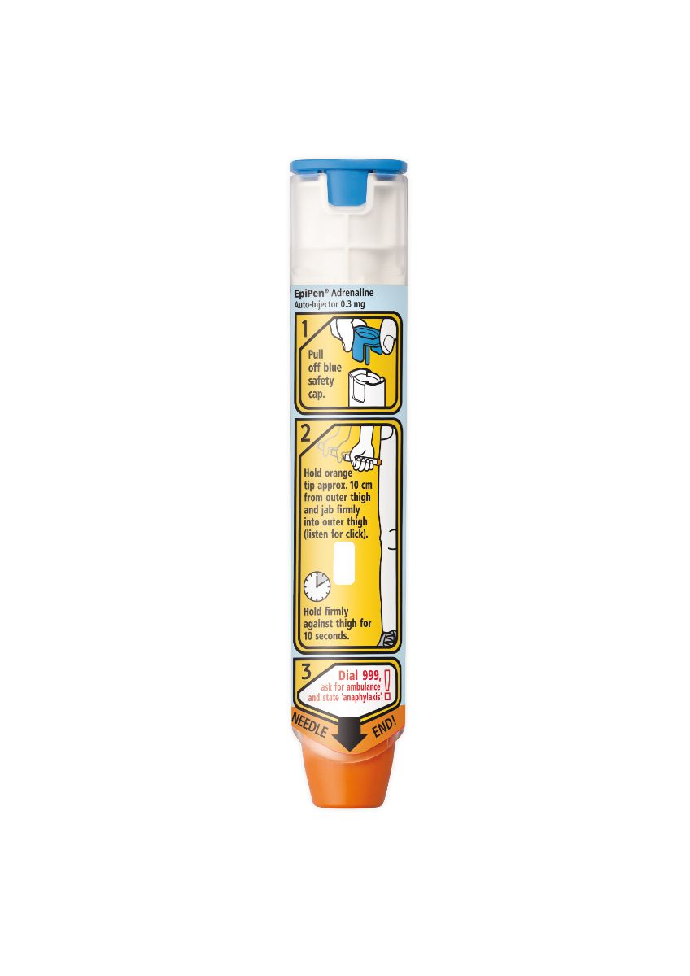
Medication by Epipen
You must be epipen/CPR certified to give a stock epipen to a student or adult without a doctor’s order.
For students with medication consents
Take out of tube
Pull cap off end
Inject right through clothing, hold 5 sec.
Call Emergency Response and 911
May need second dose.

